Slide 1
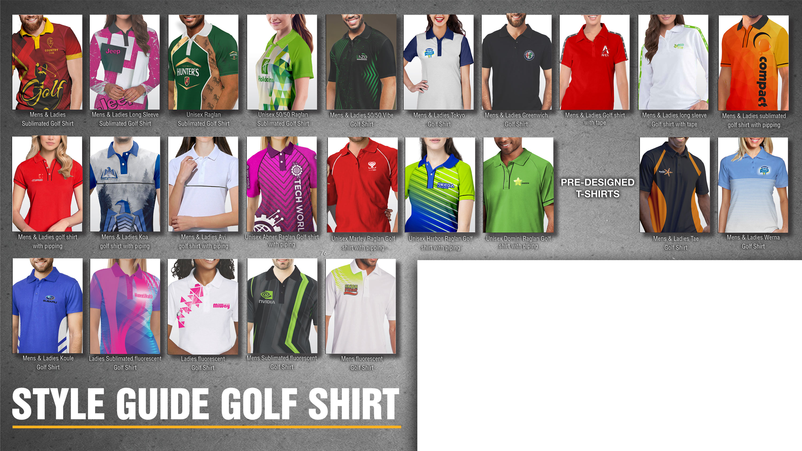

Mens and Ladies Golf Shirts
Look out for the below icon for 3D
360 rotating view
(right click on the icon to view video)

Slide 2
Our Categories
Golf Shirts
Enhance the image of your business and workforce with Golf Shirts that are sublimated Edge to Edge. They are perfect for any business looking to take advantage of the practicality , professionalism and higher-end look Golf Shirts convey.

Slide 3
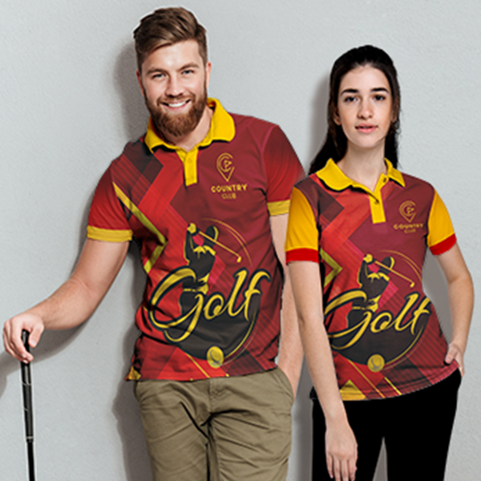

Golf Shirts - Edge to Edge Branding
Mens Takoma Moisture Management Sublimation Golf Shirt
Product Code : APP10013
Ladies Takoma Moisture Management Sublimation Golf Shirt
Product Code : APP10014
Branding: Custom Design Full Colour Included in Price
Material: 150g Polyester Interlock
Sizes: S,M,L,XL,2XL,3XL,4XL,5XL
Additional: Alternative materials available Polyester Interlock & Polyester Spun poly – request pricing

Slide 4
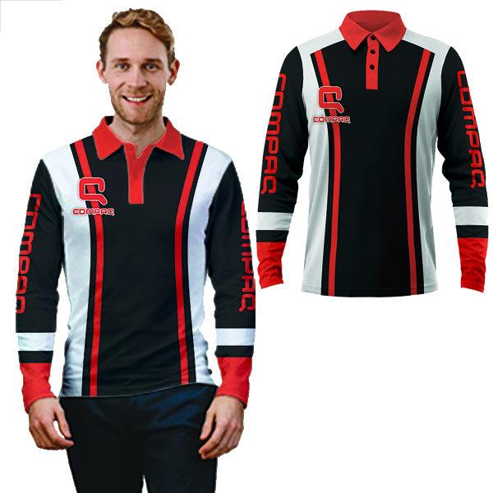
Golf Shirts – Long Sleeve – Edge to Edge Branding
Mens Basel Moisture Management Long Sleeve Sublimation Golf Shirt
Product Code : APP10095
Branding: Custom Design Full Colour Included in Price
Material: 150g Polyester Interlock
Sizes: S,M,L,XL,2XL,3XL,4XL,5XL
Additional: Alternative materials available Polyester Interlock & Polyester Spun poly – request pricing

Slide 5
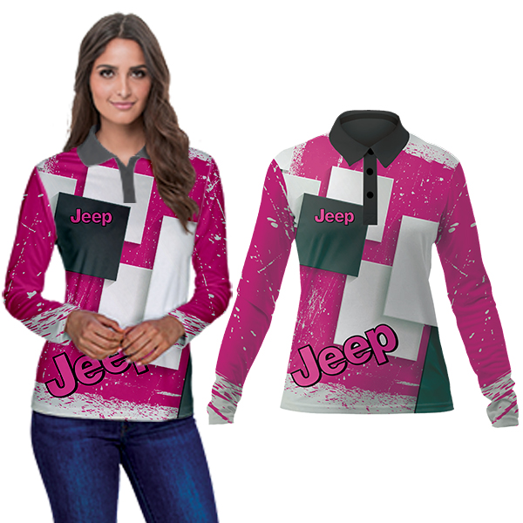
Golf Shirts – Long Sleeve – Edge to Edge Branding
Ladies Basel Moisture Management Long Sleeve Sublimation Golf Shirt
Product Code : APP10097
Branding: Custom Design Full Colour Included in Price
Material: 150g Polyester Interlock
Sizes: S,M,L,XL,2XL,3XL,4XL,5XL
Additional: Alternative materials available Polyester Interlock & Polyester Spun poly – request pricing

Slide 6
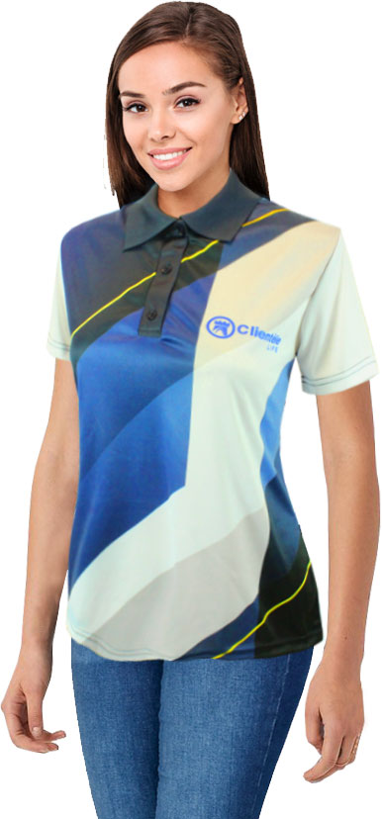
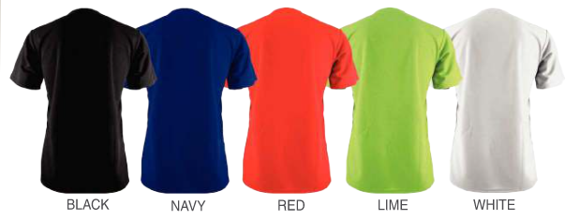
Golf Shirts – 50/50 Full colour on front only
Ladies 50/50 Moisture Management Long Sleeve Sublimation Golf Shirt
Product Code : APP50025
Branding: Custom Design Full Colour Included in Price
Material: 150g Polyester Interlock
Sizes: S,M,L,XL,2XL,3XL,4XL,5XL
Additional: Alternative material available Polyester Interlock

Slide 7
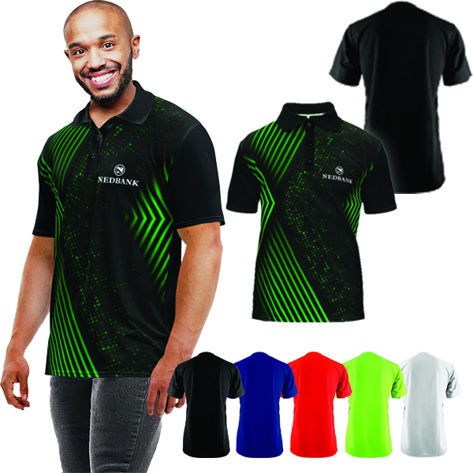
Golf Shirts – 50/50 Full colour on front only
Mens Vibe 50/50 Moisture Management Long Sleeve Sublimation Golf Shirt
Product Code : APP50022
Branding: Custom Design Full Colour Included in Price
Material: 150g Polyester Interlock
Sizes: S,M,L,XL,2XL,3XL,4XL,5XL
Additional: Alternative material available Polyester Interlock

Slide 8

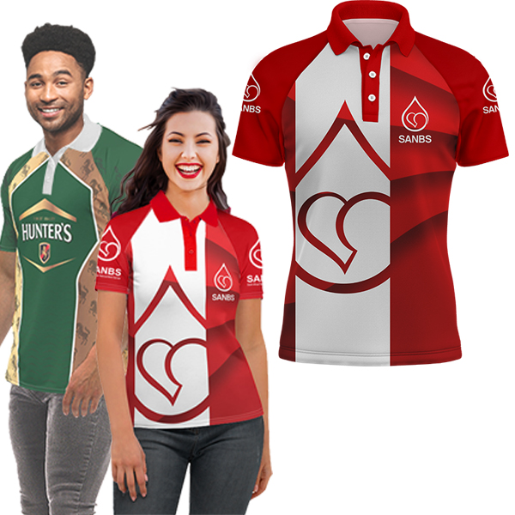
Unisex Golf Shirts – Edge to Edge Branding
Unisex Raglan Short Sleeve Golf Shirt with Sublimation Print
Product Code : APP307
Branding: Custom Design Full Colour Included in Price
Material: 150g Polyester Interlock
Sizes: S,M,L,XL,2XL,3XL,4XL,5XL
Additional: Alternative materials available Polyester Interlock & Polyester Spun poly – request pricing

Slide 9
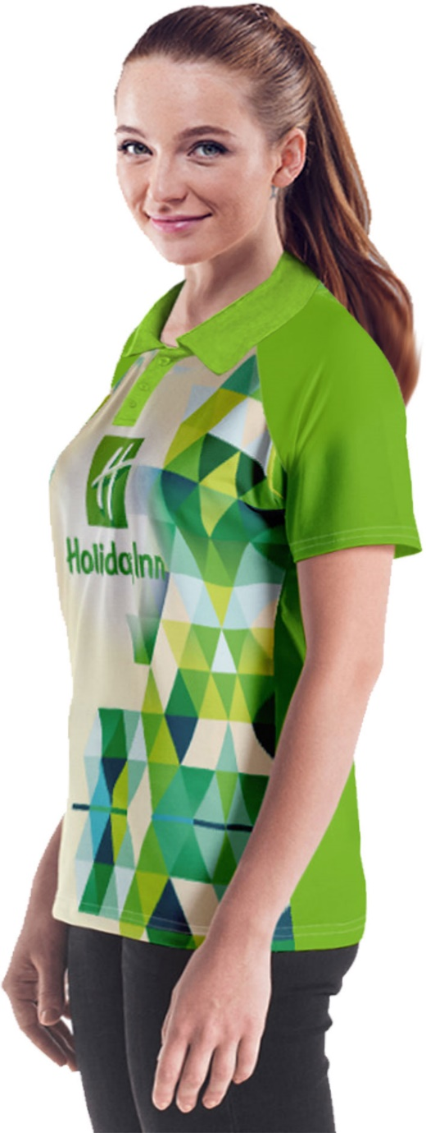
Unisex Golf Shirts – 50/50 Full colour on front only
Unisex 50/50 Short Sleeve Raglan Golf Shirt
Product Code : APP309
Branding: Custom Design Full Colour Included in Price
Material: 150g Polyester Interlock
Sizes: S,M,L,XL,2XL,3XL,4XL,5XL
Additional: Alternative material available Polyester Interlock

Slide 10

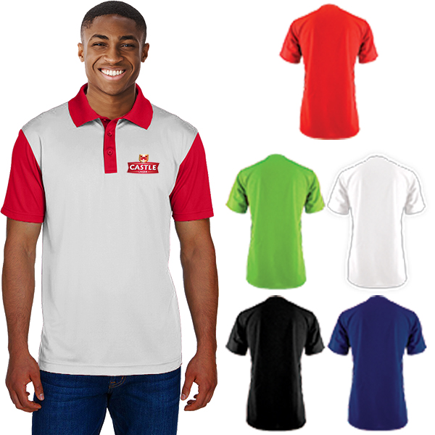
Golf Shirts – Spot Sublimation Print
Mens Tokyo Moisture Management Golf Shirt
Product Code : APP7013
Branding: Custom Design Full Colour Included in Price
Material: 150g Polyester Birdseye
Variants: Black, Navy, Lime, Red, Solid White
Sizes: S,M,L,XL,2XL,3XL,4XL,5XL
Extras: Free Spot Sublimation Branding.
Additional branding option: DTF
Additional: Alternative material available Polyester Interlock

Slide 11
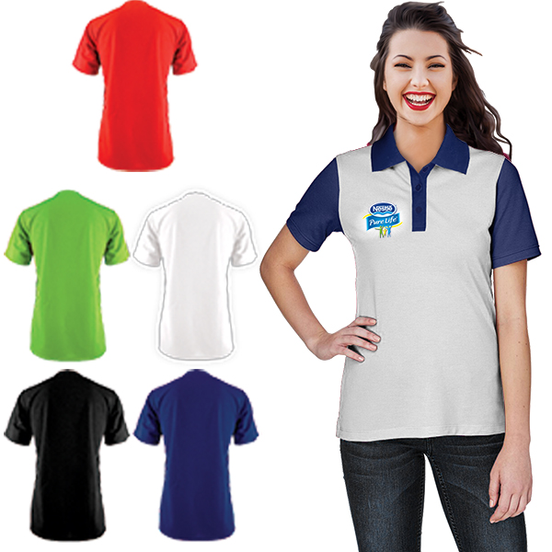
Golf Shirts – Golf Shirts – Spot Sublimation Print
Ladies Tokyo Moisture Management Golf Shirt
Product Code : APP7011
Branding: Custom Design Full Colour Included in Price
Material: 150g Polyester Birdseye
Variants: Black, Navy, Lime, Red, Solid White
Sizes: S,M,L,XL,2XL,3XL,4XL,5XL
Extras: Free Spot Sublimation Branding
Additional branding option: DTF
Additional: Alternative material available Polyester Interlock

Slide 12
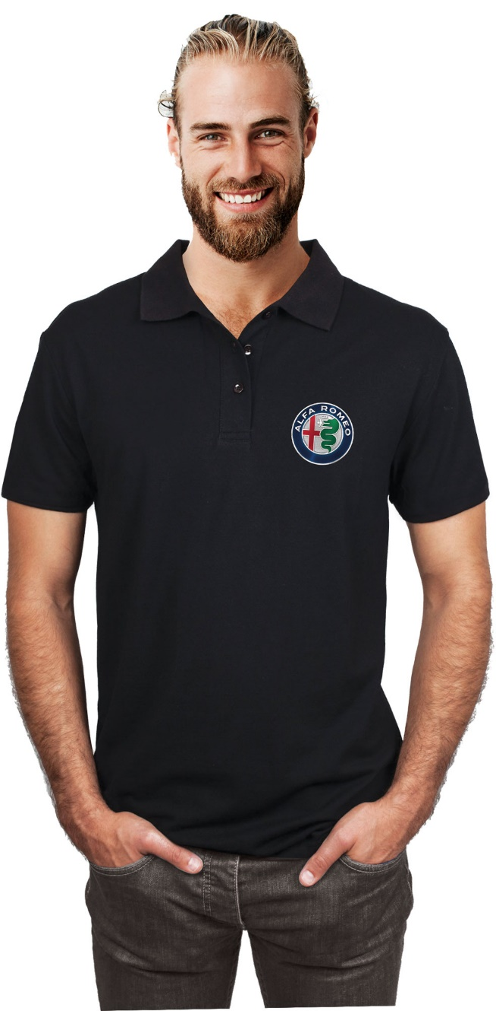
Golf Shirts – DTF Print Full colour Position
Mens Greenwhich Moisture Management Golf Shirt with Full Colour DDT print
Product Code : APP1008A
Branding: Custom Design spot DTF included in Price
Material: 150g Polyester Birdseye
Variants: Black, Navy, Lime, Red, Solid White
Sizes: S,M,L,XL,2XL,3XL,4XL,5XL
Extras: Spot Sublimation available on white shirt
Additional: Alternative material available Polyester Interlock

Slide 13

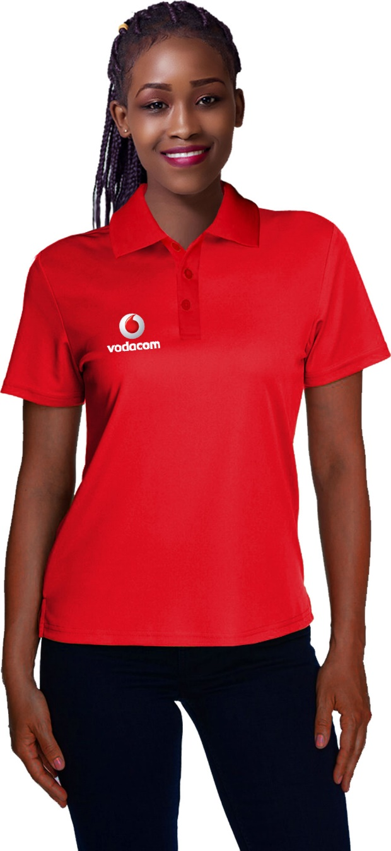
Golf Shirts – DTF Print Full colour 1 Position
Ladies Greenwhich Moisture Management Golf Shirt with Full Colour DTF print
Product Code : APP1009A
Branding: Custom Design spot DTF included in Price
Material: 150g Polyester Birdseye
Variants: Black, Navy, Lime, Red, Solid White
Sizes: S,M,L,XL,2XL,3XL,4XL,5XL
Extras: Spot Sublimation available on white shirt
Additional: Alternative material available Polyester Interlock

Slide 14
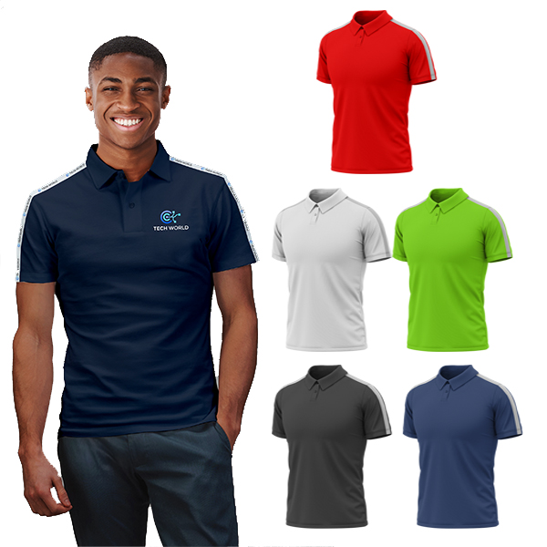
Golf Shirts with Printed Tape Detail
Mens Austin Moisture Management Golf Shirt with Full Colour Branded Tape Detail
Product Code : APP7276
Branding: Sublimated tape detail on shoulder
Material: Polyester Birdseye Moisture Management
Variants: Black, Navy, Lime, Red, Solid White
Sizes: S,M,L,XL,2XL,3XL,4XL,5XL
Extra: Additional print available as screen print or DTF on shirt for additional cost
Additional: Alternative material available Polyester Interlock

Slide 15
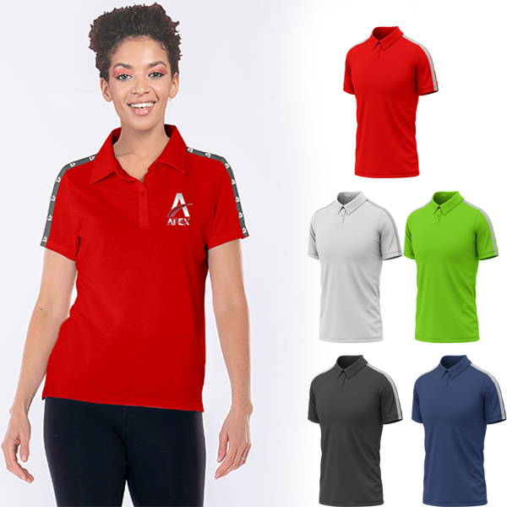
Golf Shirts with Printed Tape Detail
Ladies Austin Moisture Management Golf Shirt with Full Colour Branded Tape Detail
Product Code : APP7278
Branding: Sublimated tape detail on shoulders
Material: Polyester Birdseye Moisture Management
Variants: Black, Navy, Lime, Red, Solid White
Sizes: XS,S,M,L,XL,2XL,3XL,4XL,5XL
Extra: Additional print available as screen print or DTF on shirt for additional cost
Additional: Alternative material available Polyester Interlock

Slide 16
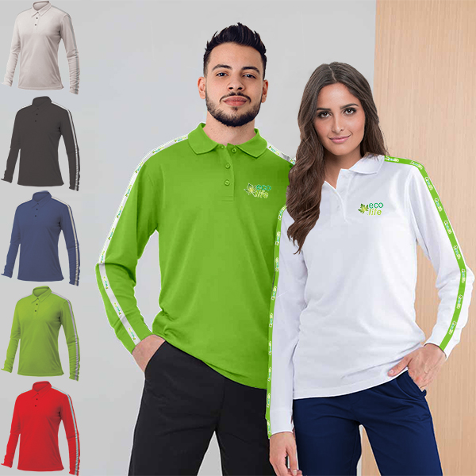
Golf Shirts with Printed Tape Detail
Mens Logan Long Sleeve Moisture Management Golf Shirt with Full Colour Branded Tape Detail
Product Code : APP7280
Ladies Logan Long Sleeve Moisture Management Golf Shirt with Full Colour Branded Tape Detail
Product Code : APP7282
Branding: Sublimated tape detail on shoulder and sleeves
Material: Polyester Birdseye Moisture Management
Variants: Black, Navy, Lime, Red, Solid White
Sizes: S,M,L,XL,2XL,3XL,4XL,5XL
Extra: Additional print available as screen print or DTF on shirt for additional cost
Additional: Alternative material available Polyester Interlock

Slide 17
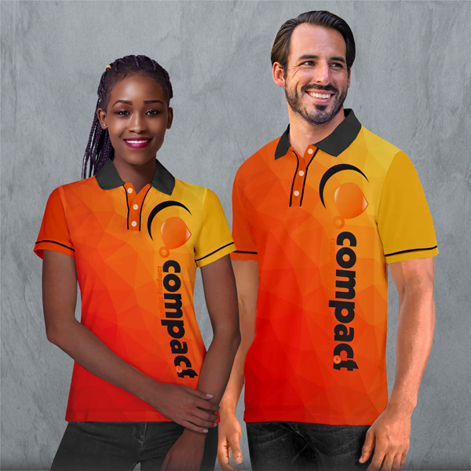
Golf Shirts with Piping Tape Detail
Ladies Nolan Moisture Management Golf Shirt
Product Code : APP7176
Mens Nolan Moisture Management Golf Shirt
Product Code : APP7173
Branding: Custom Design Full Colour Included in Price
Material: Polyester Birdseye Moisture Management
Sizes: XS,S,M,L,XL,2XL,3XL,4XL,5XL
Additional: Alternative materials available Polyester Interlock & Polyester Spun poly – request pricing

Slide 18
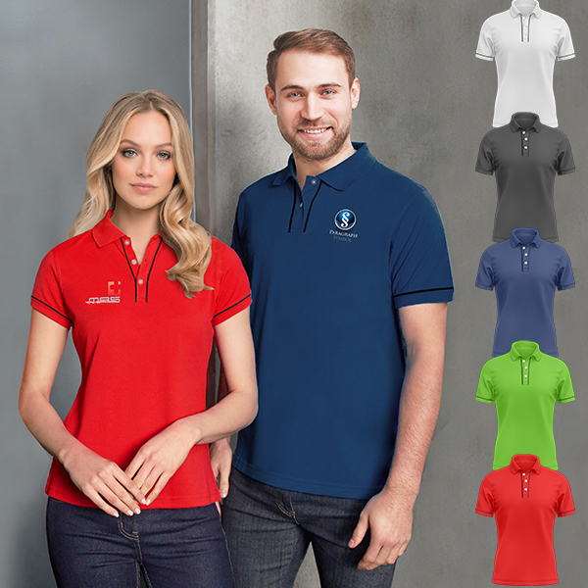
Golf Shirts with Piping Tape Detail
Ladies Miles Moisture Management Golf Shirt
Product Code : APP7183
Mens Miles Moisture Management Golf Shirt
Product Code : APP7180
Branding: Custom design spot DTF included in Price
Material: Polyester Birdseye Moisture Management
Variants: Black, Navy, Lime, Red, Solid White
Sizes: XS,S,M,L,XL,2XL,3XL,4XL,5XL
Additional: Alternative material available Polyester Interlock

Slide 19
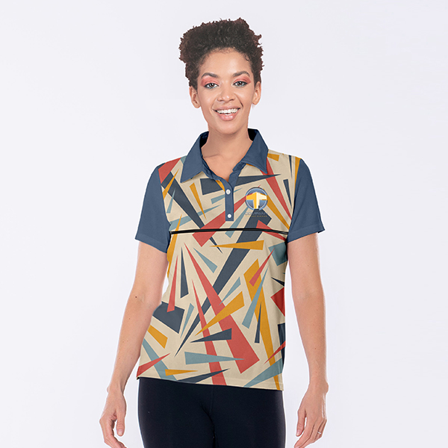
Golf Shirts with Piping Tape Detail
Ladies Koa Moisture Management Golf Shirt
Product Code : APP7188
Branding: Custom Design Full Colour Included in Price
Material: Polyester Birdseye Moisture Management
Sizes: XS,S,M,L,XL,2XL,3XL,4XL,5XL
Additional: Alternative materials available Polyester Interlock & Polyester Spun poly – request pricing

Slide 20
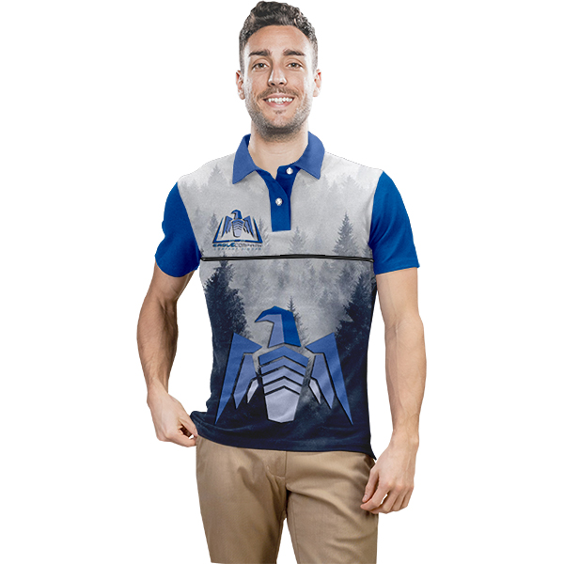
Golf Shirts with Piping Tape Detail
Mens Koa Moisture Management Golf Shirt
Product Code : APP7185
Branding: Custom Design Full Colour Included in Price
Material: Polyester Birdseye Moisture Management
Sizes: XS,S,M,L,XL,2XL,3XL,4XL,5XL
Additional: Alternative materials available Polyester Interlock & Polyester Spun poly – request pricing

Slide 21
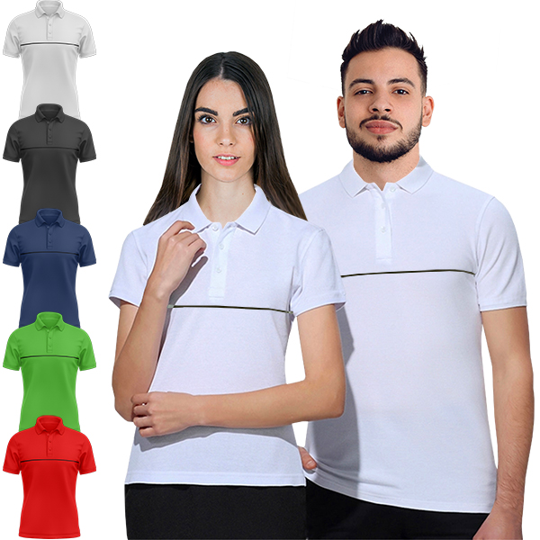
Golf Shirts with Piping Tape Detail
Ladies Avi Moisture Management Golf Shirt
Product Code : APP7195
Mens Avi Sleeve Moisture Management Golf Shirt
Product Code : APP7192
Branding: Custom design spot DTF included in Price
Variants: Black, Navy, Lime, Red, Solid White
Material: Polyester Birdseye Moisture Management
Sizes: XS,S,M,L,XL,2XL,3XL,4XL,5XL
Additional: Alternative material available Polyester Interlock

Slide 22
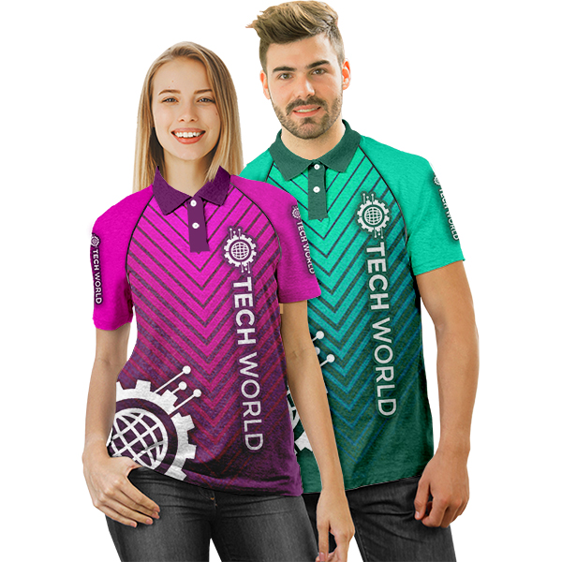
Raglan Golf Shirts with Piping Tape Detail
Unisex Abner Raglan Moisture Management Golf Shirt
Product Code : APP7197
Branding: Custom Design Full Colour Included in Price
Material: Polyester Birdseye Moisture Management
Sizes: XS,S,M,L,XL,2XL,3XL,4XL,5XL
Additional: Alternative materials available Polyester Interlock & Polyester Spun poly – request pricing

Slide 23
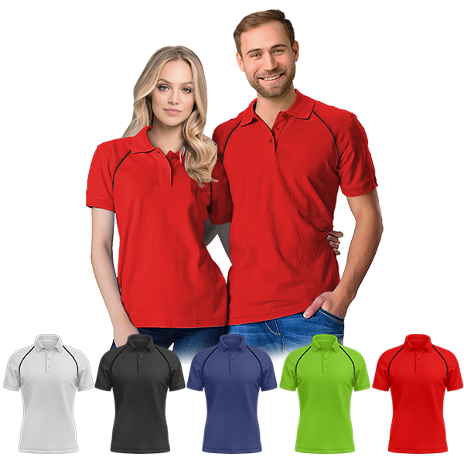
Raglan Golf Shirts with Piping Tape Detail
Unisex Marley Raglan Moisture Management Golf Shirt
Product Code : APP7200
Branding: Custom design spot DTF included in Price
Variants: Black, Navy, Lime, Red, Solid White
Material: Polyester Birdseye Moisture Management
Sizes: XS,S,M,L,XL,2XL,3XL,4XL,5XL
Additional: Alternative material available Polyester Interlock

Slide 24
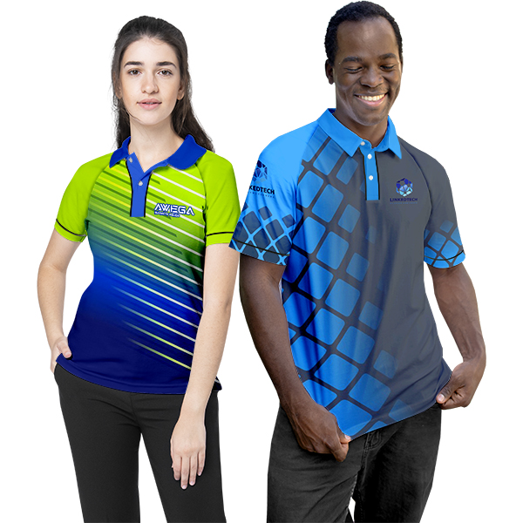
Raglan Golf Shirts with Piping Tape Detail
Unisex Harbor Raglan Moisture Management Golf Shirt
Product Code : APP7285
Branding: Custom Design Full Colour Included in Price
Material: Polyester Birdseye Moisture Management
Sizes: XS,S,M,L,XL,2XL,3XL,4XL,5XL
Additional: Alternative materials available Polyester Interlock & Polyester Spun poly – request pricing

Slide 25
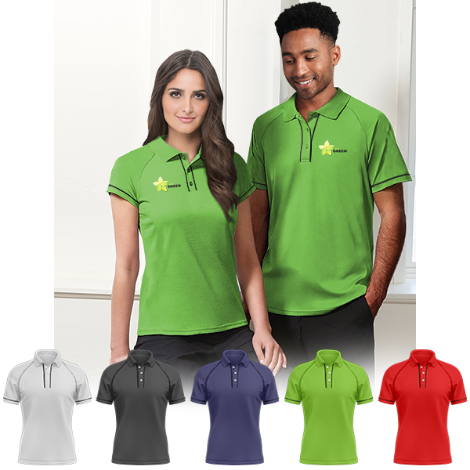
Raglan Golf Shirts with Piping Tape Detail
Unisex Domini Raglan Moisture Management Golf Shirt
Product Code : APP7289
Branding: Custom design spot DTF included in Price
Variants: Black, Navy, Lime, Red, Solid White
Material: Polyester Birdseye Moisture Management
Sizes: XS,S,M,L,XL,2XL,3XL,4XL,5XL
Additional: Alternative material available Polyester Interlock

Slide 26
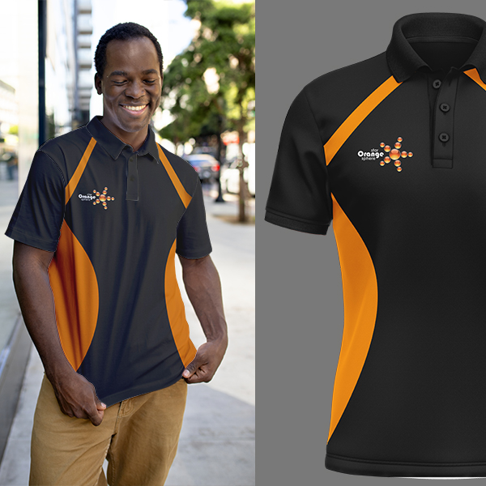
Golf Shirts with Pre-designed artworks – Just add your logo
Mens Tae Moisture Management Golf Shirt
Product Code : APP7089
Branding: Custom Design Full Colour Included in Price
Material: Polyester Birdseye Moisture Management
Variants: Green, Lime, Royal blue, Orange, Red, Grey
Sizes: XS,S,M,L,XL,2XL,3XL,4XL,5XL
Additional: Alternative materials available Polyester Interlock & Polyester Spun poly – request pricing

Slide 27
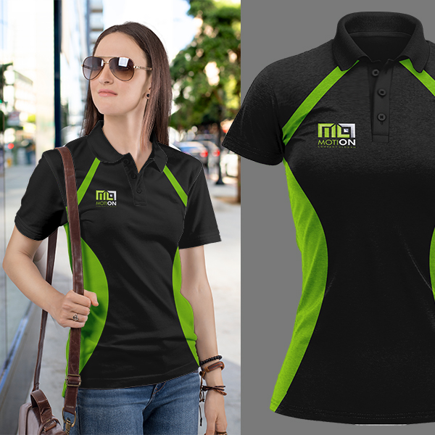
Golf Shirts with Pre-designed artworks – Just add your logo
Ladies Tae Moisture Management Golf Shirt
Product Code : APP7089
Branding: Custom Design Full Colour Included in Price
Material: Polyester Birdseye Moisture Management
Variants: Green, Lime, Royal blue, Orange, Red, Grey
Sizes: XS,S,M,L,XL,2XL,3XL,4XL,5XL
Additional: Alternative materials available Polyester Interlock & Polyester Spun poly – request pricing

Slide 28
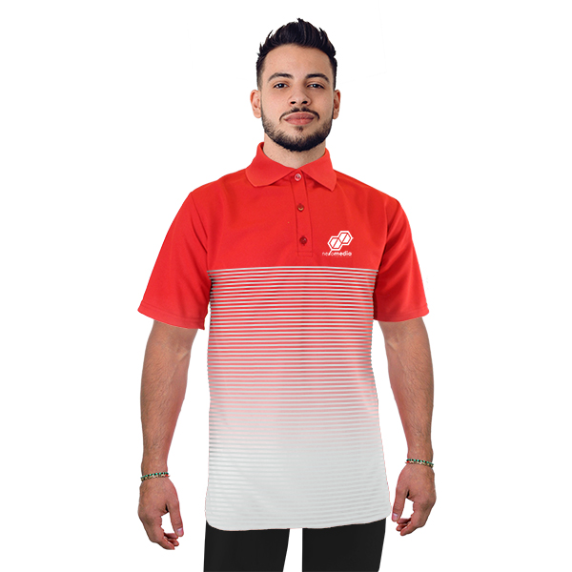
Golf Shirts with Pre-designed artworks – Just add your logo
Mens Werna Moisture Management Golf Shirt
Product Code : APP7083
Branding: Custom Design Full Colour Included in Price
Material: Polyester Birdseye Moisture Management
Variants: Royal blue, Navy, Red, Sky blue
Sizes: XS,S,M,L,XL,2XL,3XL,4XL,5XL
Additional: Alternative materials available Polyester Interlock & Polyester Spun poly – request pricing

Slide 29
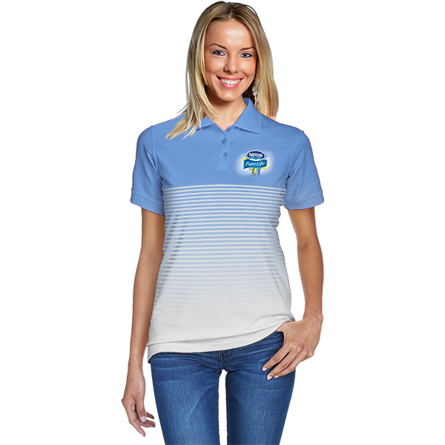
Golf Shirts with Pre-designed artworks – Just add your logo
Ladies Werna Moisture Management Golf Shirt
Product Code : APP7085
Branding: Custom Design Full Colour Included in Price
Material: Polyester Birdseye Moisture Management
Variants: Royal blue, Navy, Red, Sky blue
Sizes: XS,S,M,L,XL,2XL,3XL,4XL,5XL
Additional: Alternative materials available Polyester Interlock & Polyester Spun poly – request pricing

Slide 30
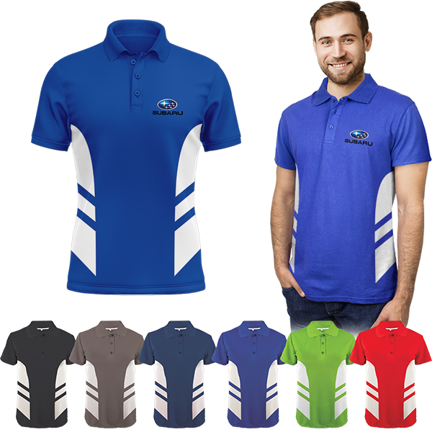
Golf Shirts with Pre-designed artworks – Just add your logo
Mens Koule Moisture Management Golf Shirt
Product Code : APP7093
Branding: Custom Design Full Colour Included in Price
Material: Polyester Birdseye Moisture Management
Variants: Black, Grey, Navy, Royal Blue, Lime, Red
Sizes: XS,S,M,L,XL,2XL,3XL,4XL,5XL
Additional: Alternative materials available Polyester Interlock & Polyester Spun poly – request pricing

Slide 31
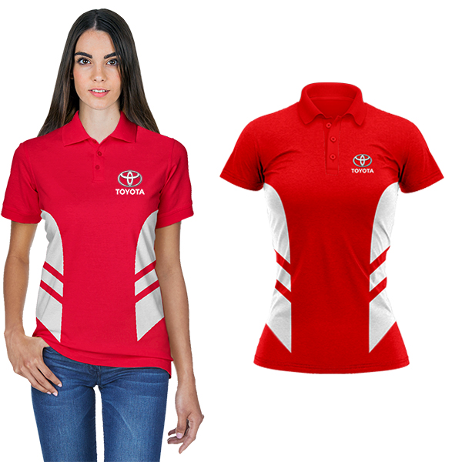
Golf Shirts with Pre-designed artworks – Just add your logo
Ladies Koule Moisture Management Golf Shirt
Product Code : APP7091
Branding: Custom Design Full Colour Included in Price
Material: Polyester Birdseye Moisture Management
Variants: Black, Grey, Navy, Royal Blue, Lime, Red
Sizes: XS,S,M,L,XL,2XL,3XL,4XL,5XL
Additional: Alternative materials available Polyester Interlock & Polyester Spun poly – request pricing

Slide 32
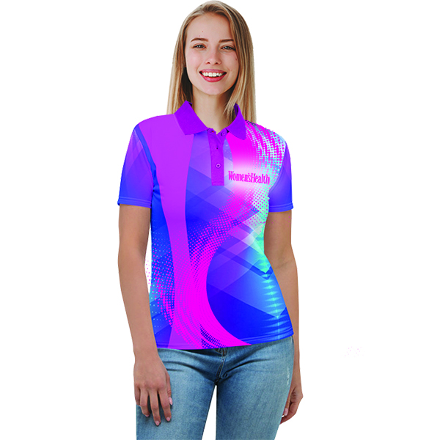
Golf Shirts with Fluorescent Sublimation Print
Ladies Fluorescent Moisture Management Golf Shirt
Product Code : APP7054
Branding: Custom Design Full Colour Included in Price
Material: Polyester Interlock Moisture Management
Sizes: XS,S,M,L,XL,2XL,3XL,4XL,5XL

Slide 33
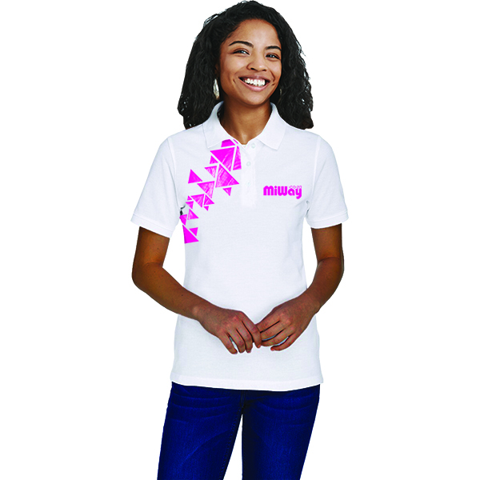
Golf Shirts with Fluorescent Sublimation Print
Ladies Fluorescent Moisture Management Golf Shirt spot sublimation
Product Code : APP7054
Branding: Custom design spot fluorescent sublimation print included in price
Material: Polyester Interlock Moisture Management
Sizes: XS,S,M,L,XL,2XL,3XL,4XL,5XL

Slide 34
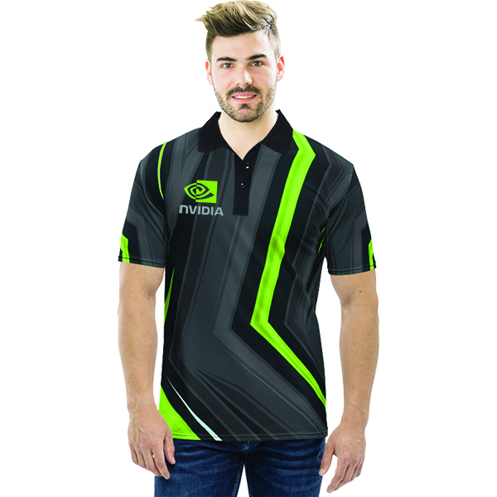
Golf Shirts with Fluorescent Sublimation Print
Mens Fluorescent Moisture Management Golf Shirt
Product Code : APP7056
Branding: Custom Design Full Colour Included in Price
Material: Polyester Interlock Moisture Management
Sizes: XS,S,M,L,XL,2XL,3XL,4XL,5XL

Slide 35
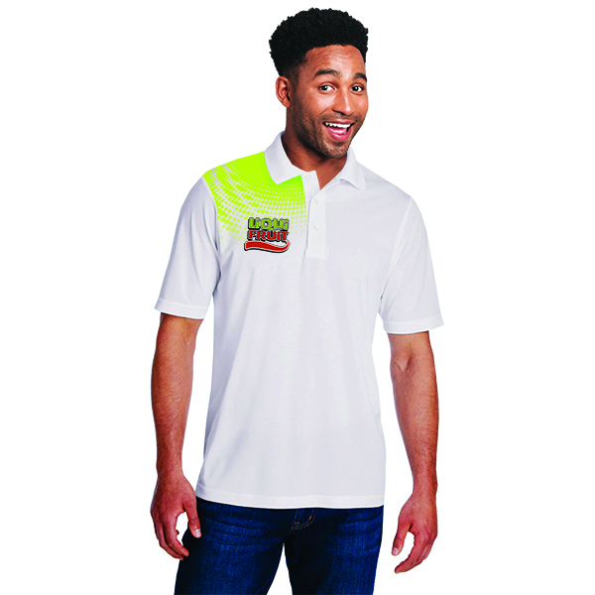
Golf Shirts with Fluorescent Sublimation Print
Mens Fluorescent Moisture Management Golf Shirt spot sublimation
Product Code : APP7057
Branding: Custom design spot fluorescent sublimation print included in price
Material: Polyester Interlock Moisture Management
Sizes: XS,S,M,L,XL,2XL,3XL,4XL,5XL

